Slide 1
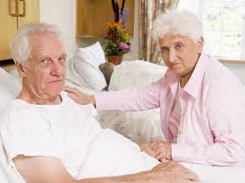
Saving Grandpa The Hungry Cells: - Jerome: Doctor, snack bringer - Abbi: Designer, cell feeder - Thea: Coder, snack eater

Slide 2

Grandpa has been saved!

Slide 3
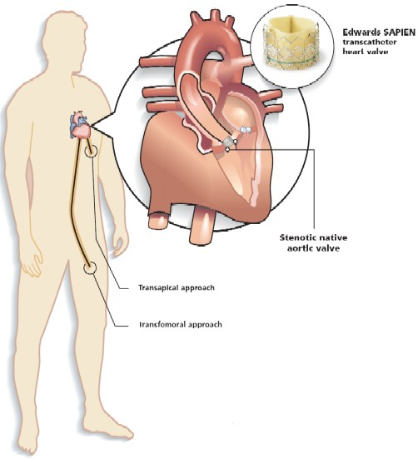
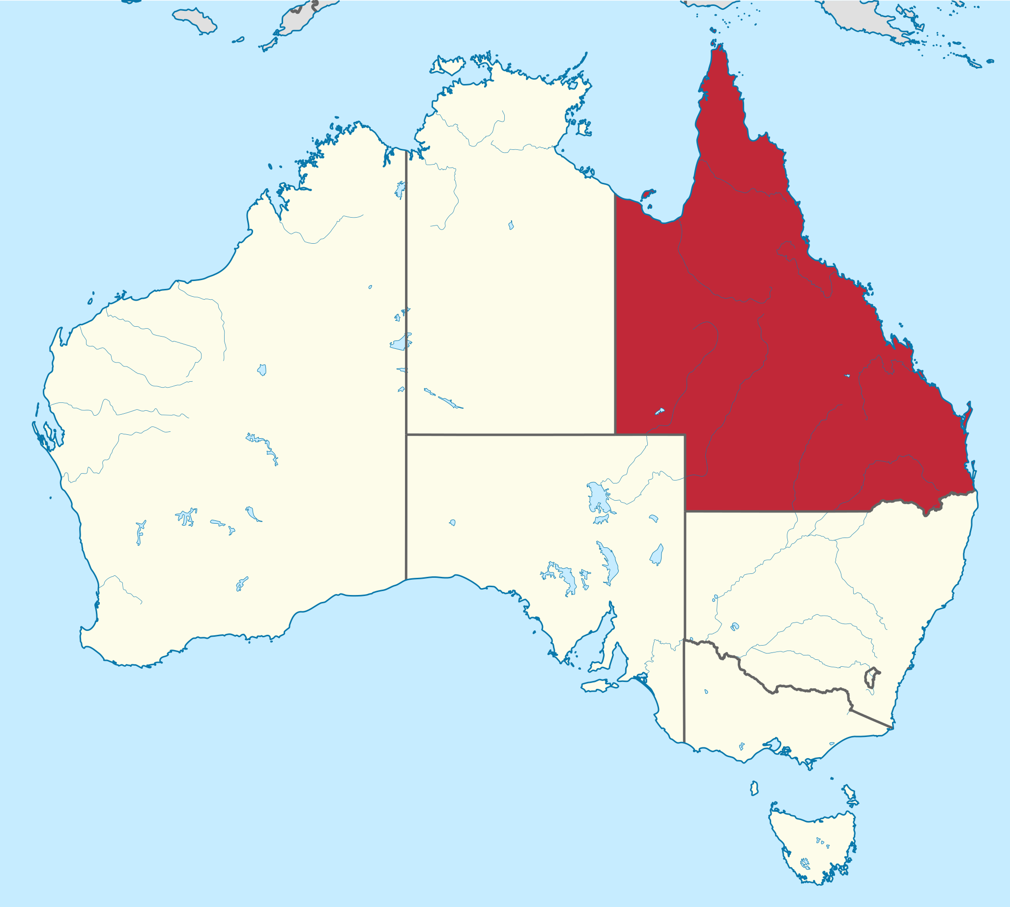

The Problem

Slide 4
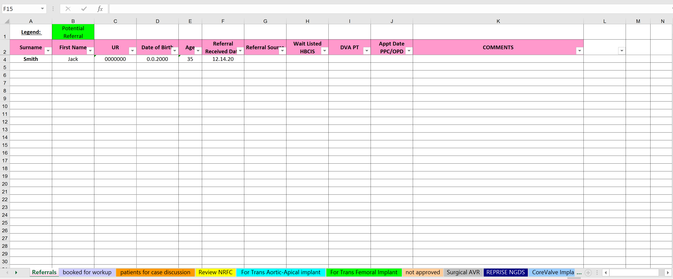
The Excel Spreadsheet

Slide 5
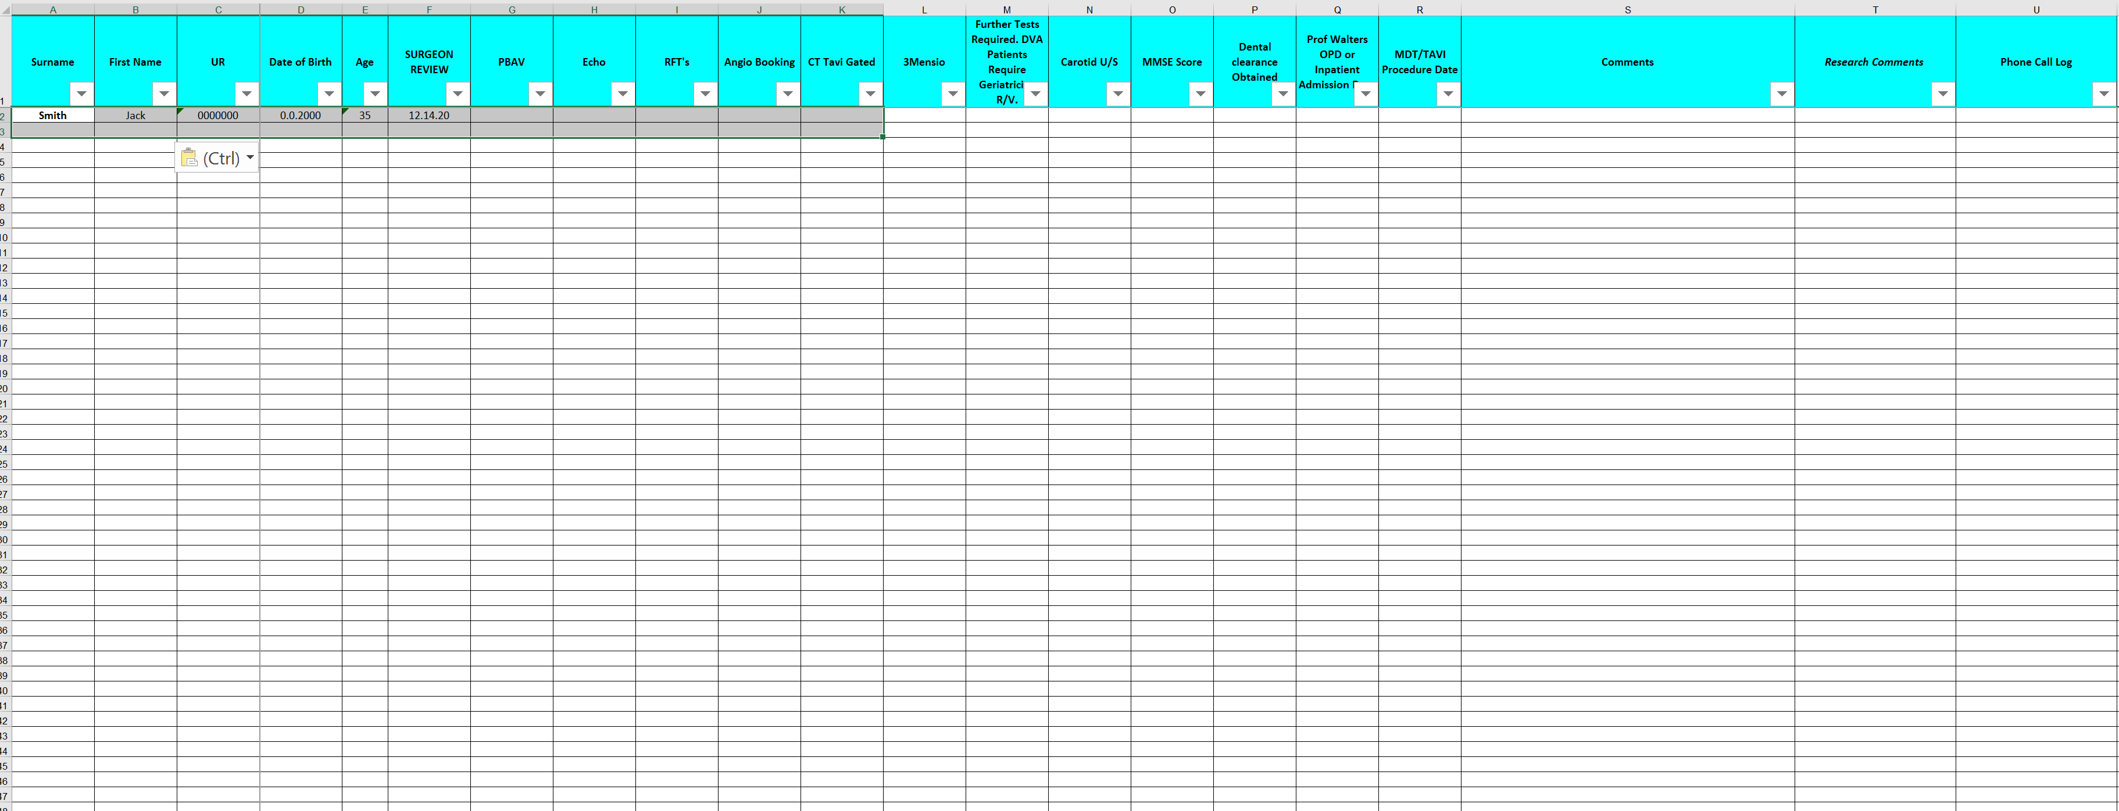
The Excel Spreadsheet

Slide 6
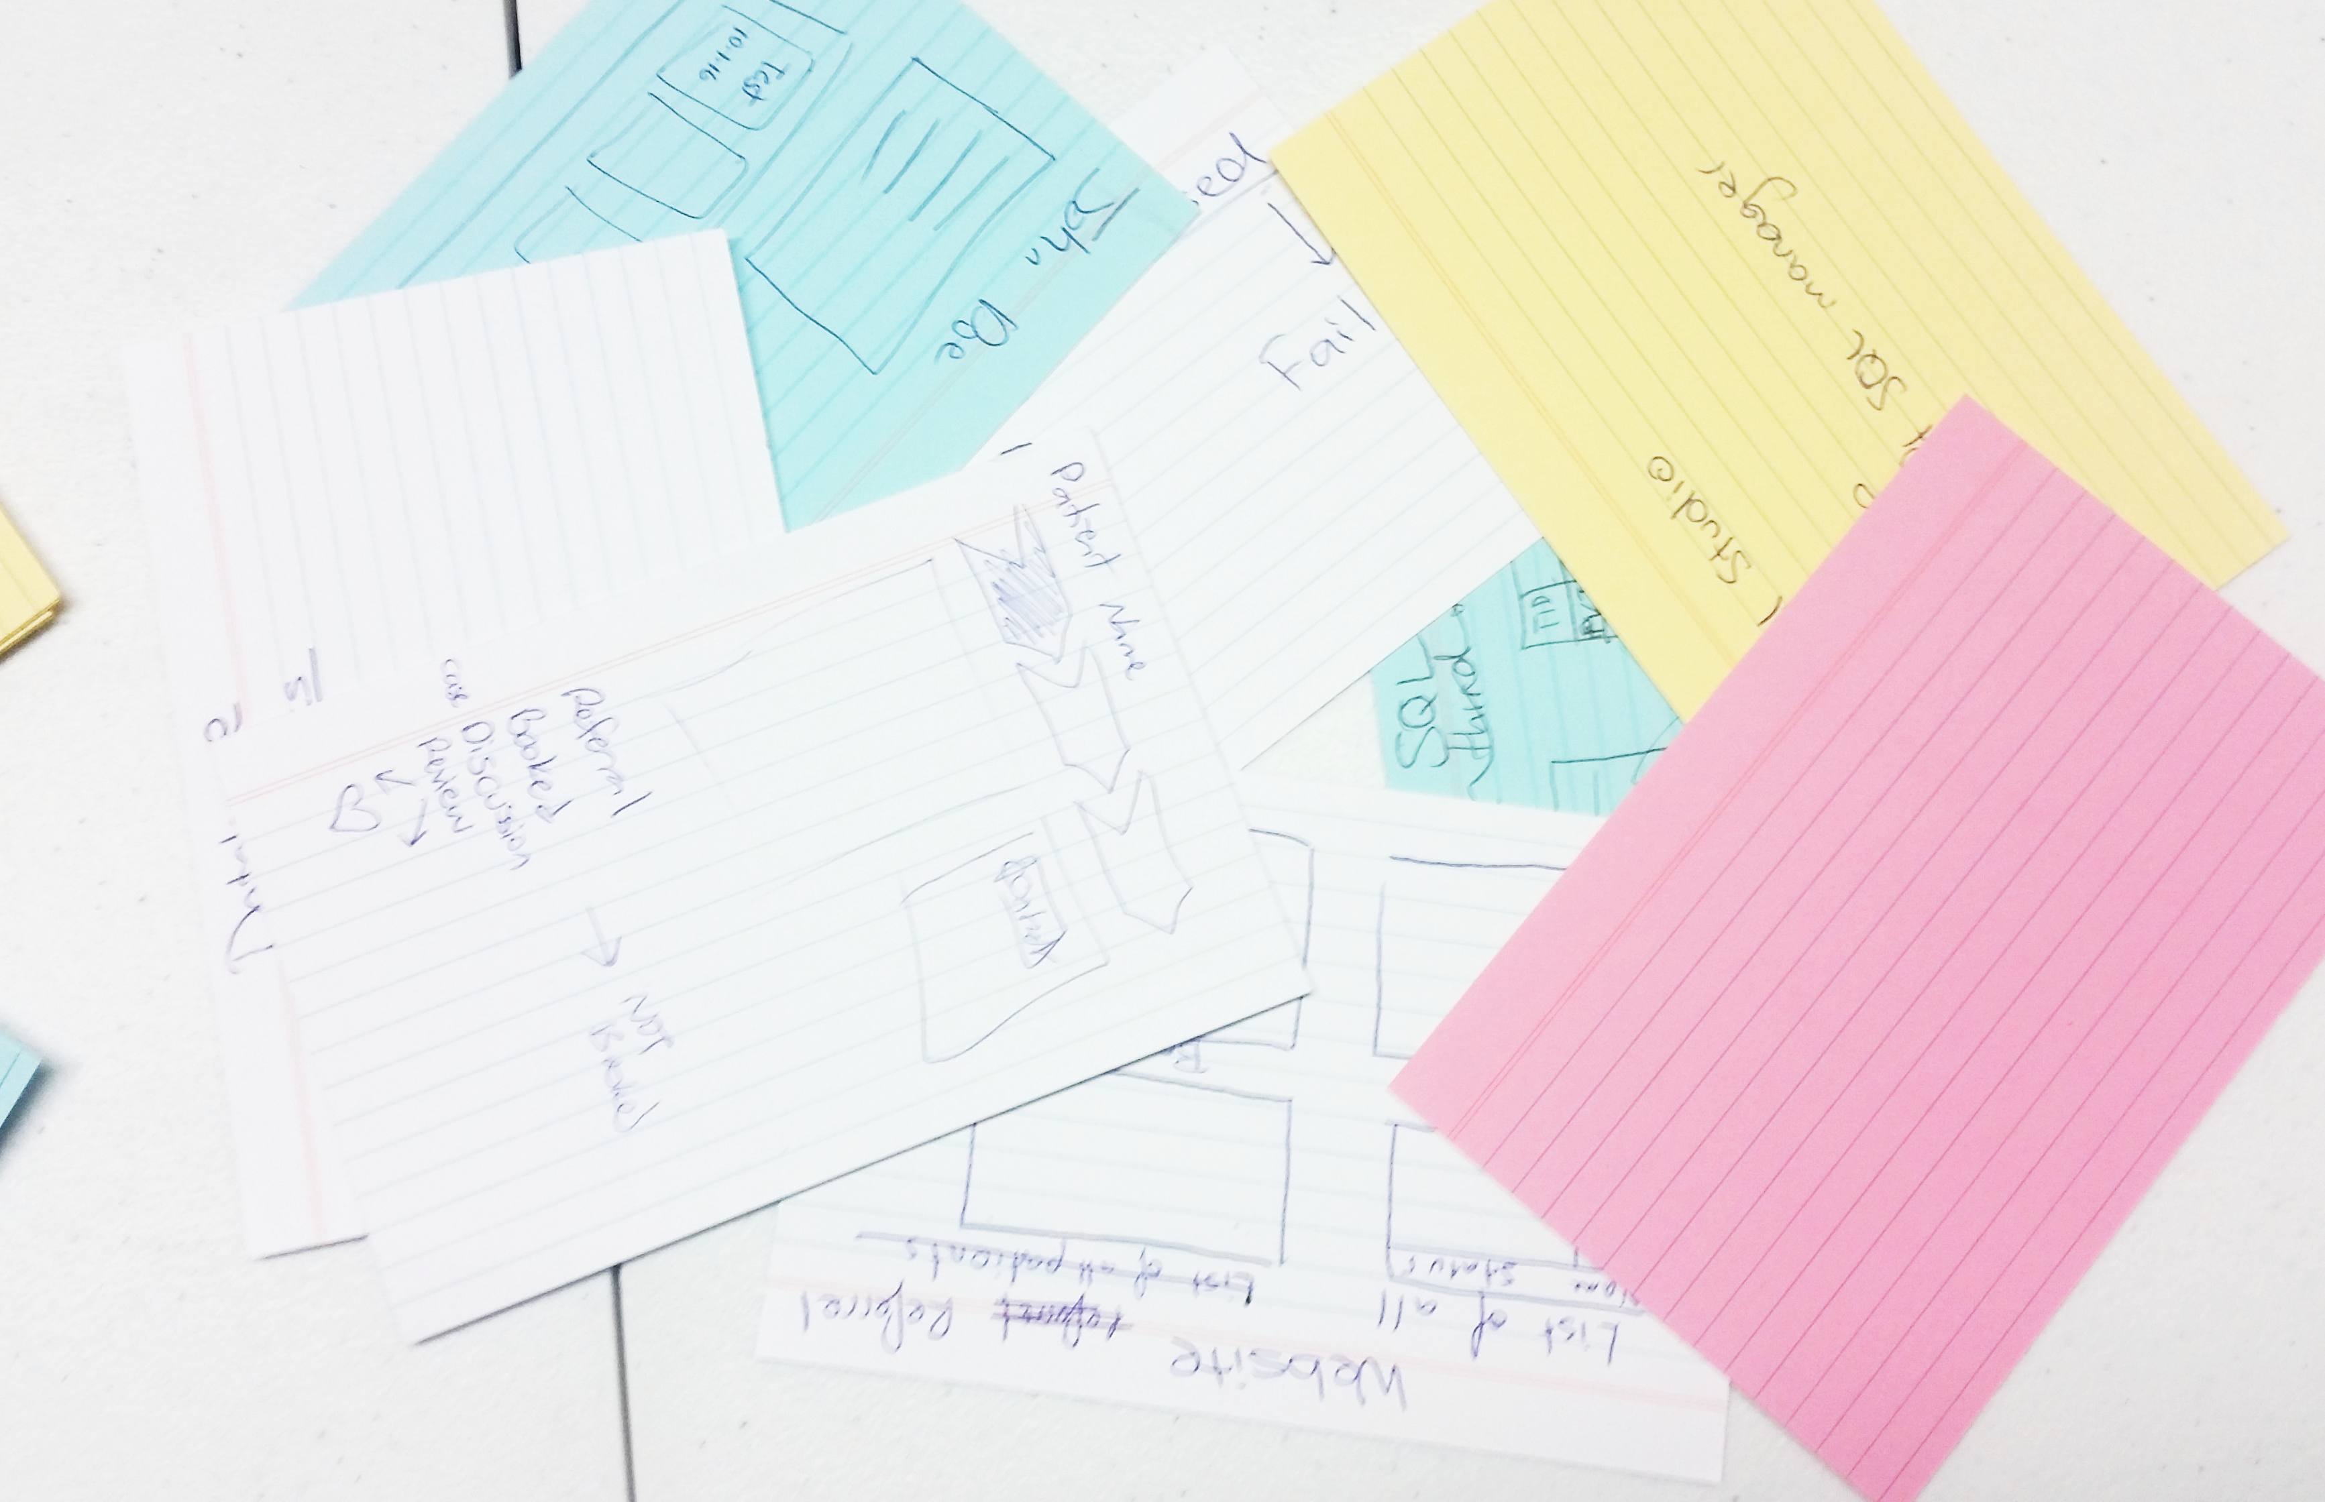


The Solution
Abbi
Thea
J

Slide 7
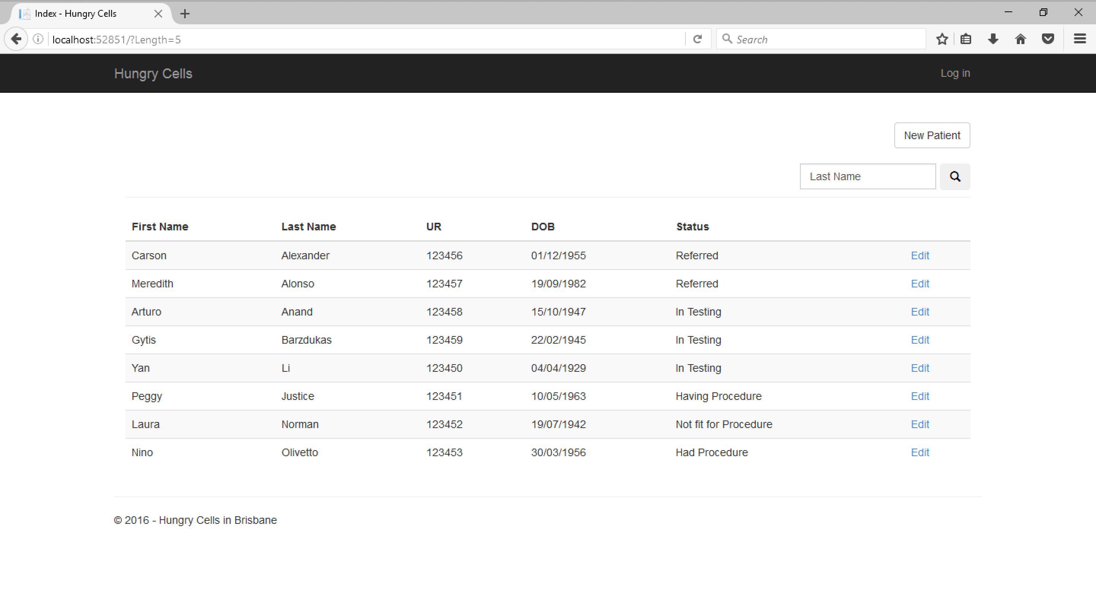
Demonstration of Hungry Cells

Slide 8
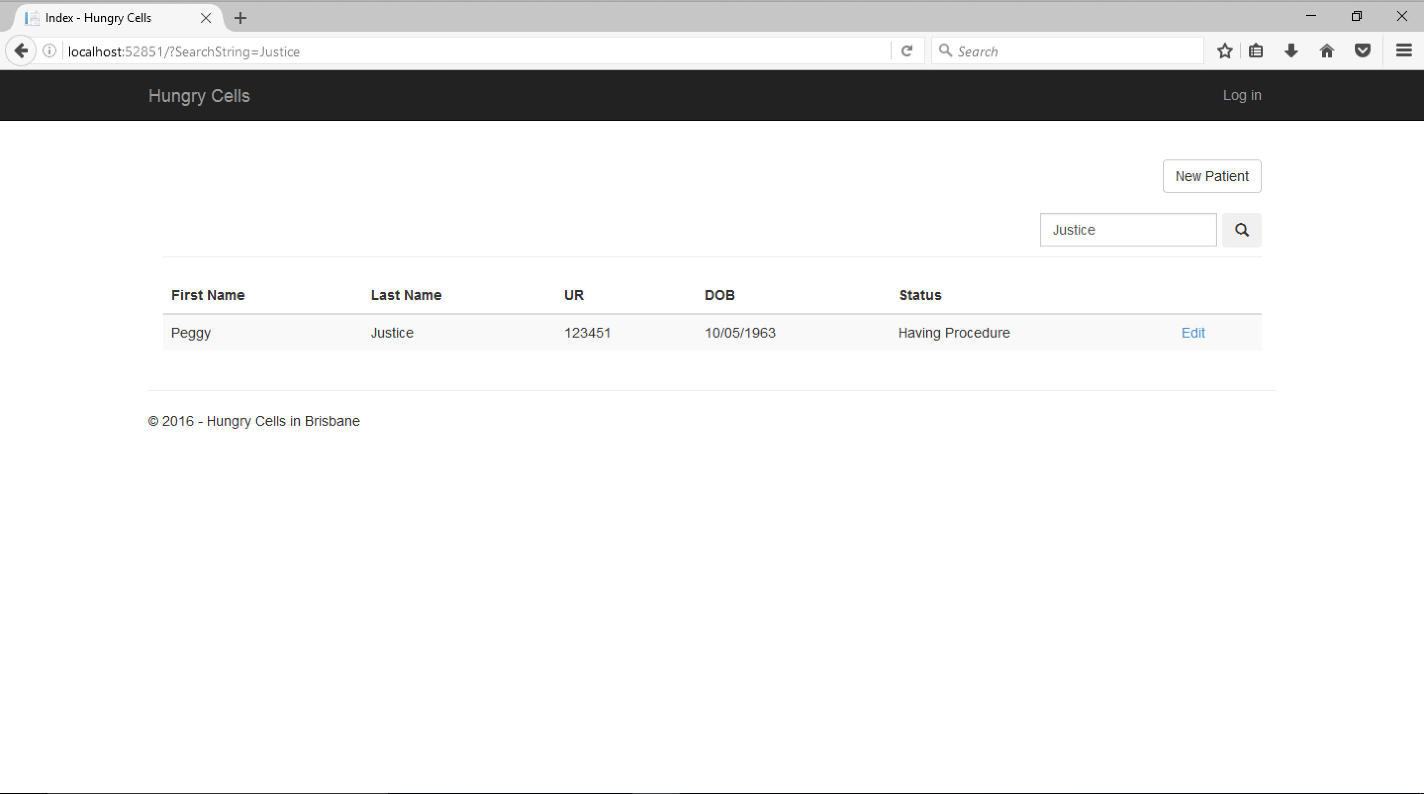
Demonstration of Hungry Cells

Slide 9
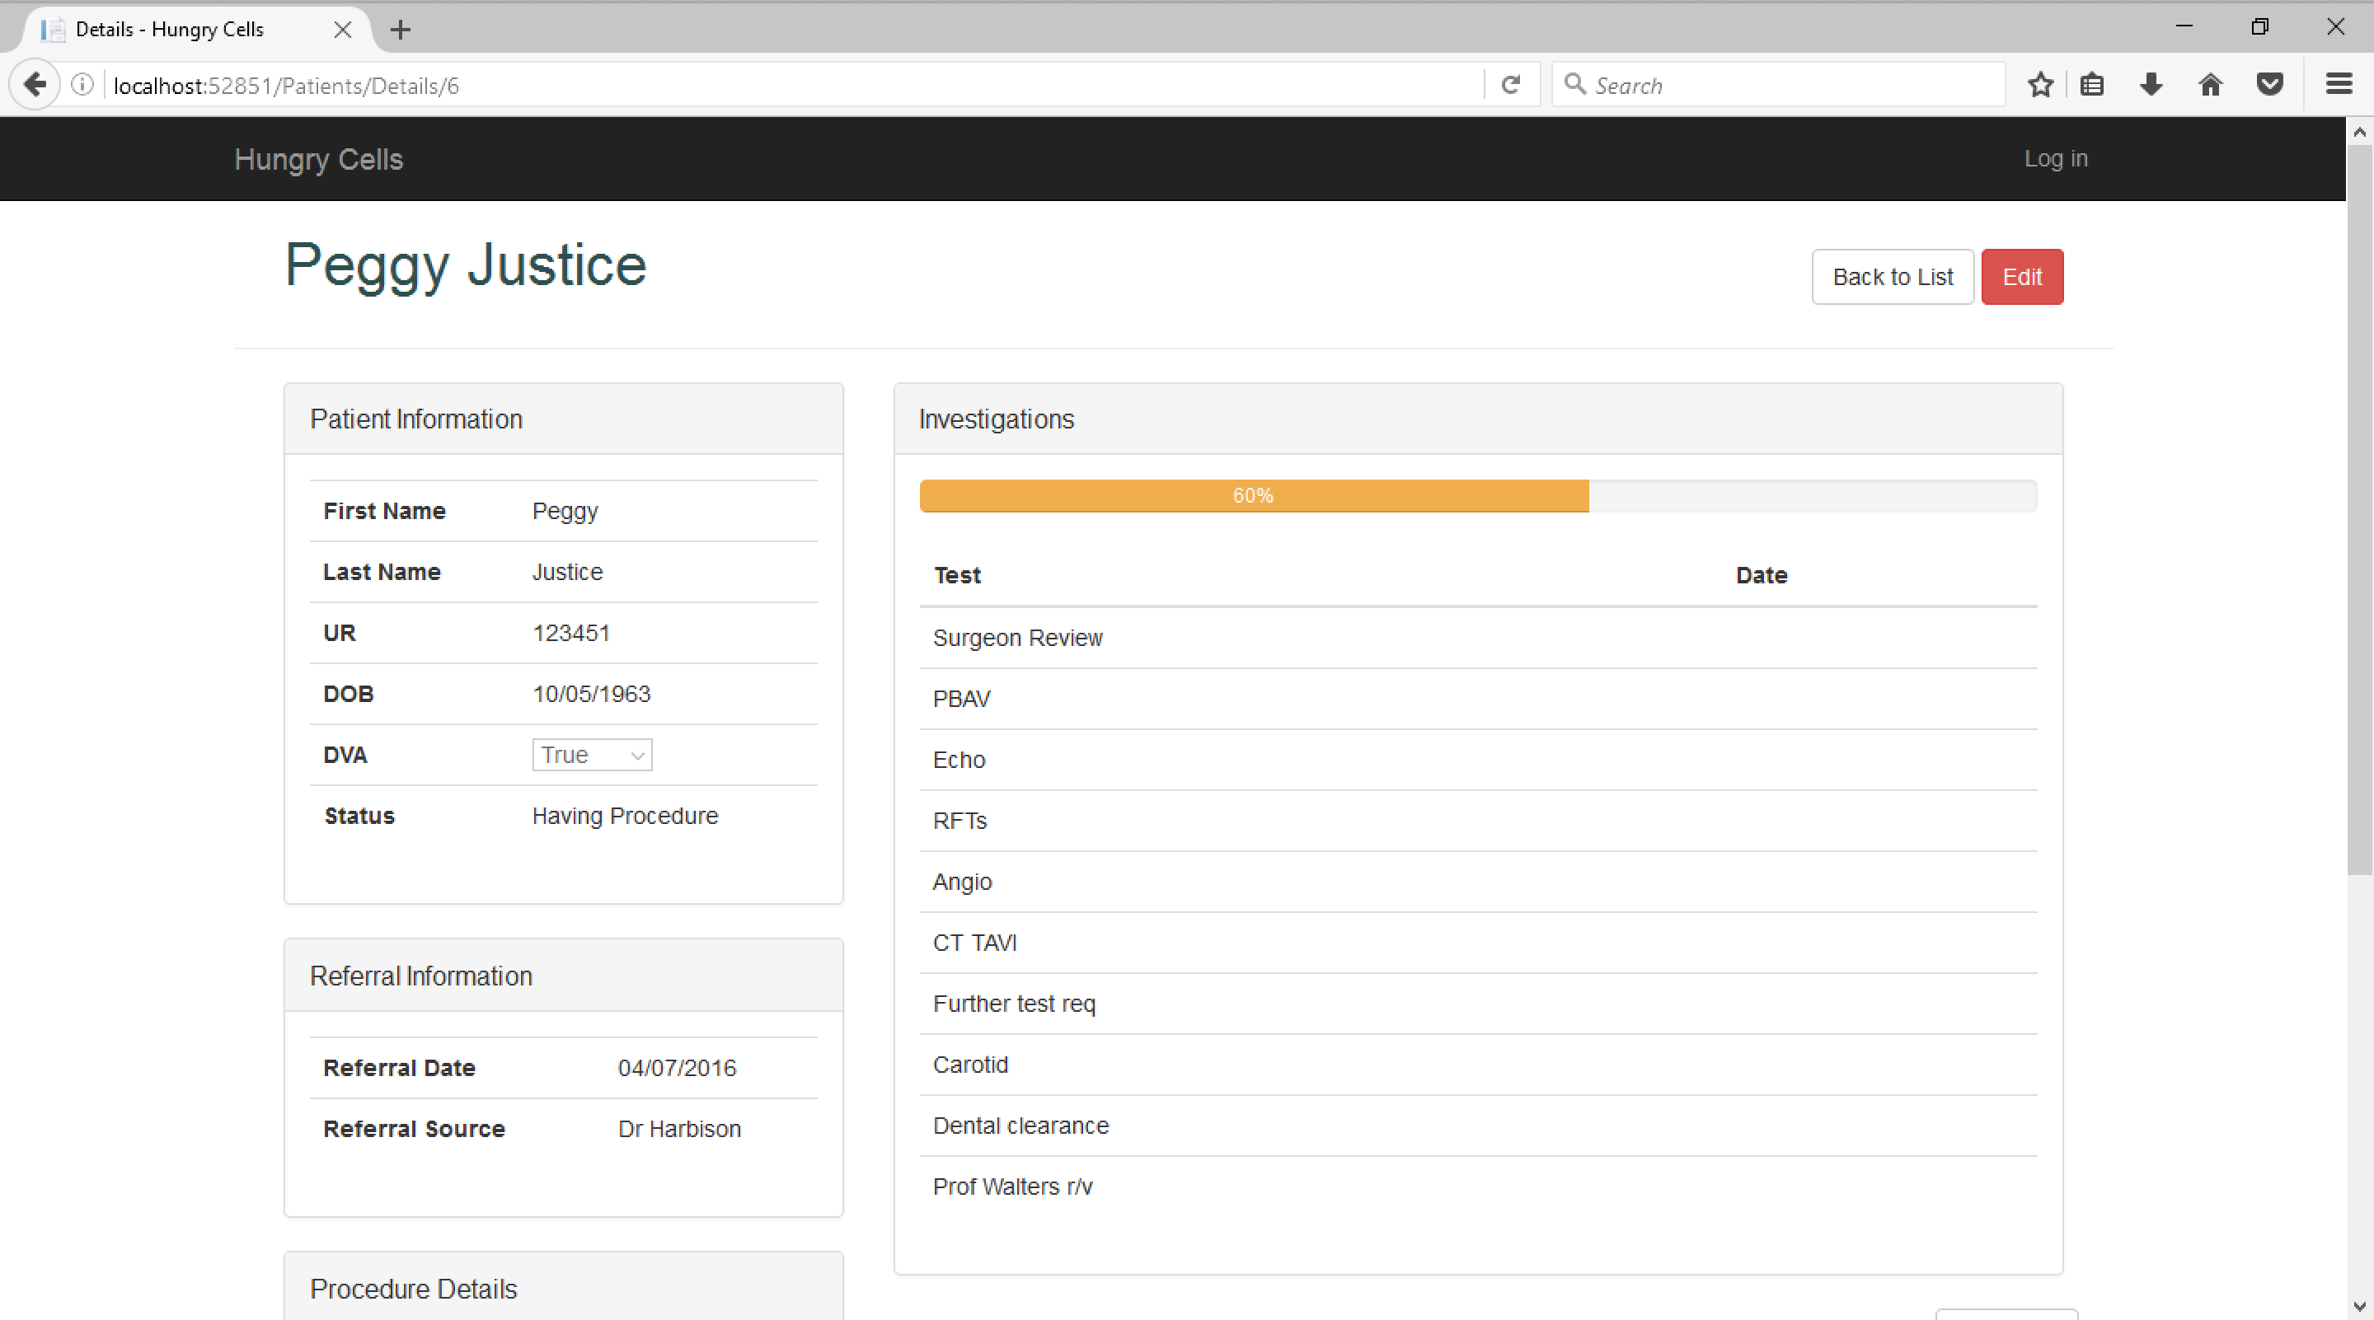
Demonstration of Hungry Cells

Slide 10
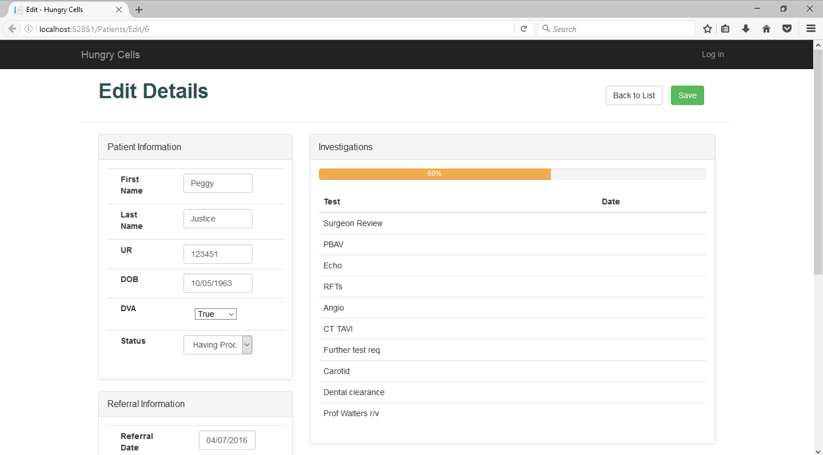
Demonstration of Hungry Cells

Slide 11
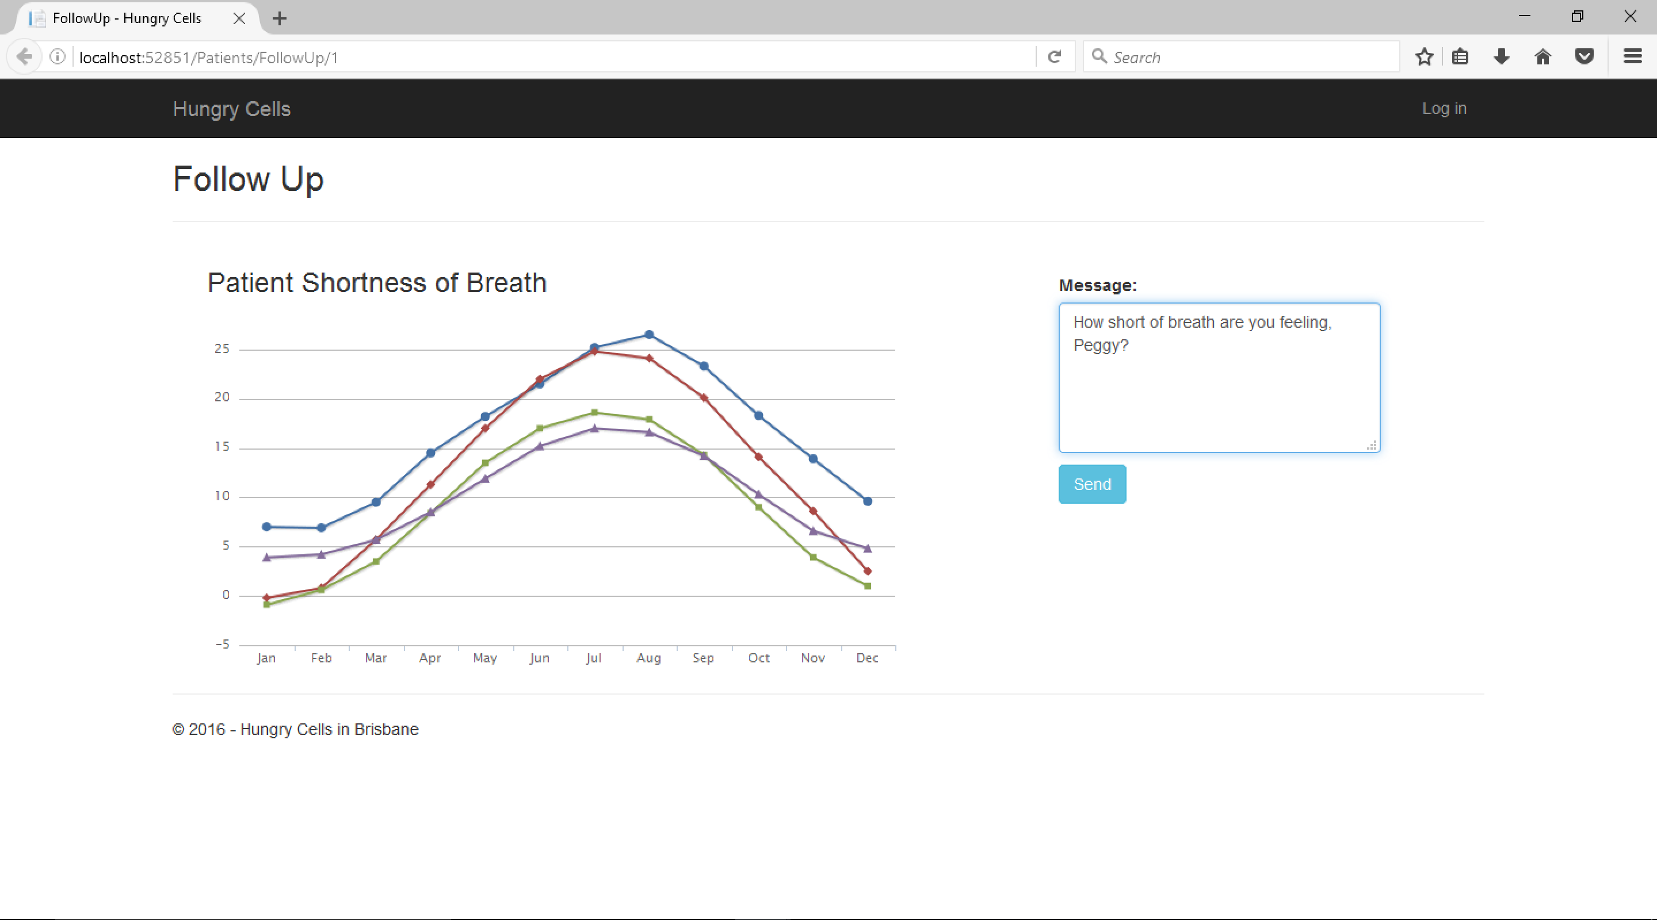
Demonstration of Hungry Cells

Slide 12
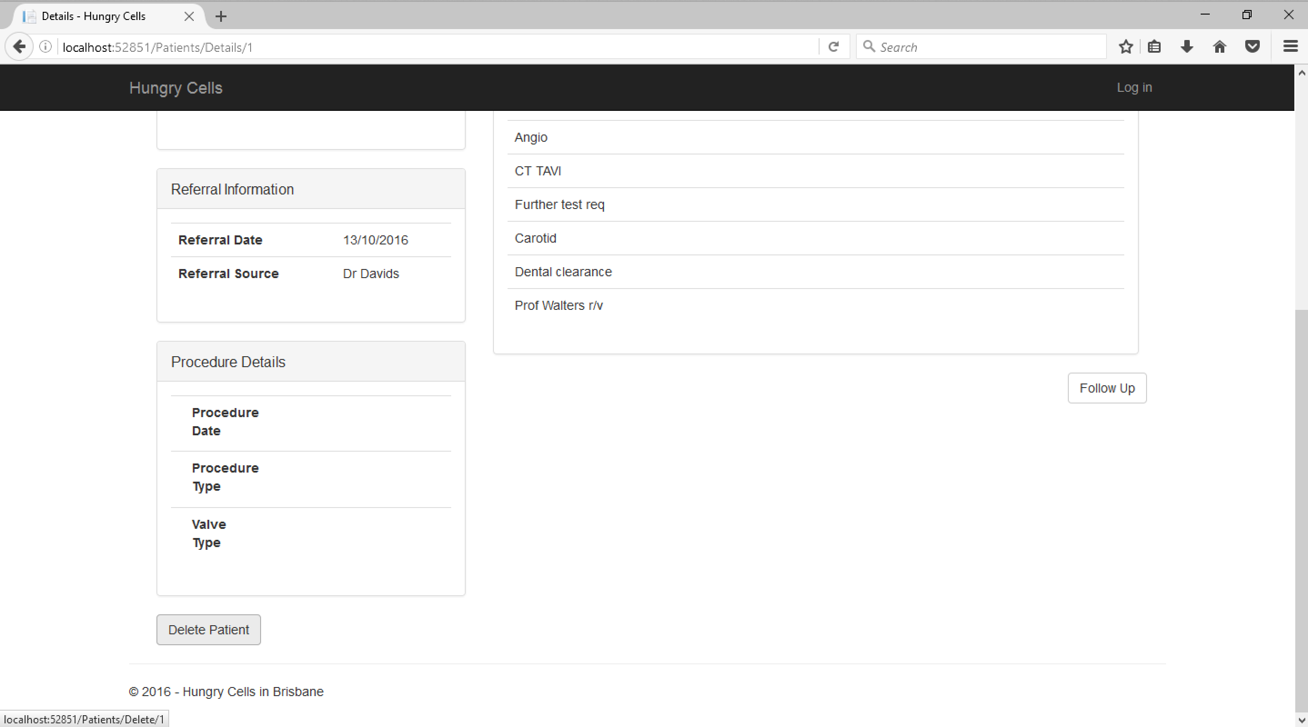
Demonstration of Hungry Cells

Slide 13
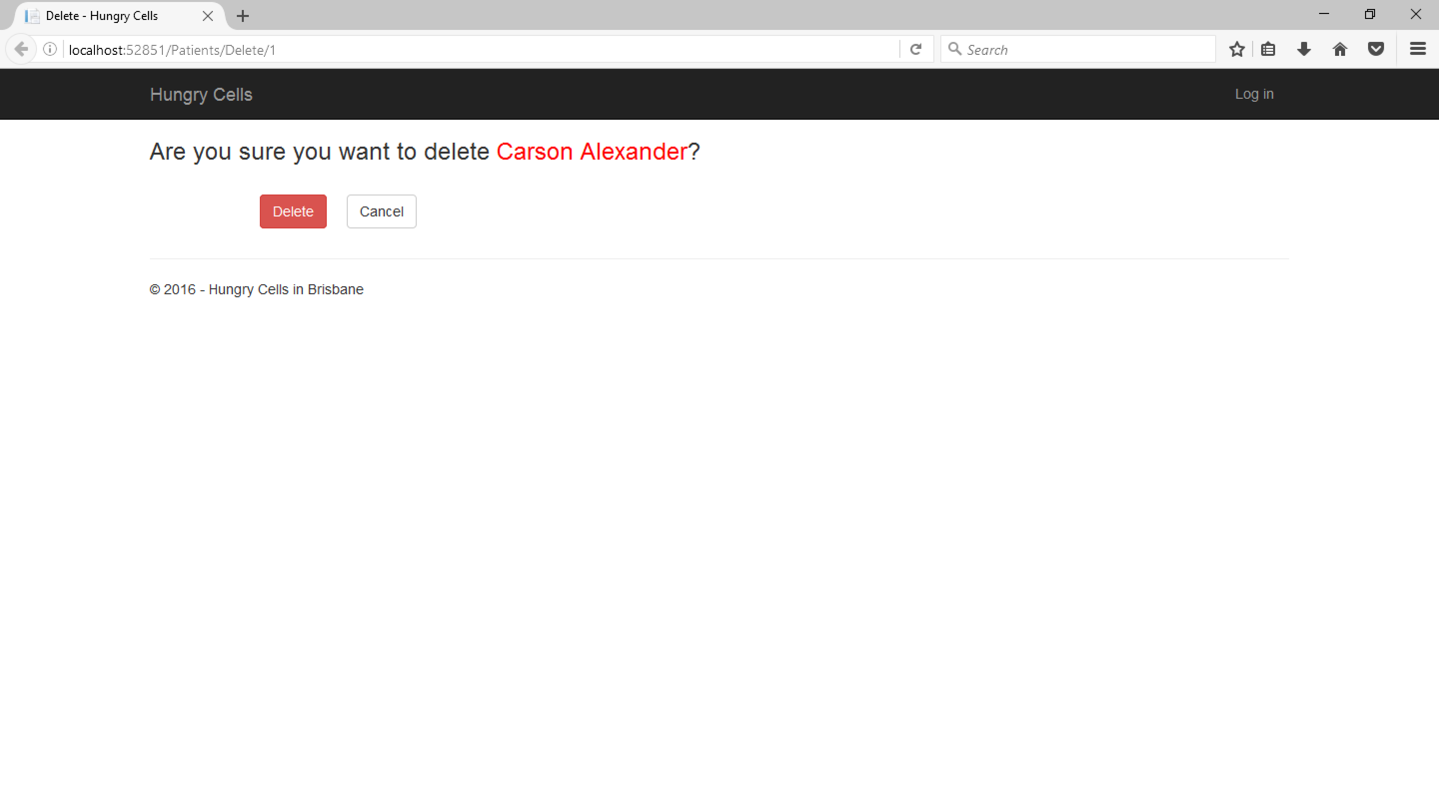
Demonstration of Hungry Cells

Slide 14
Summary
Easy to Implement
Path to implementation eased by local network
User Friendly
Scalable
Can be used in any hospital
Built with one specific procedure in mind but the same problem (ie excel!!!!!!) exists with other procedures
Documented

